Slide 1
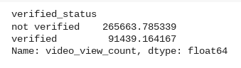
Executive Summary: Statistical Testing Results
TikTok Claims Classification Project
Project Overview
TikTok’s data team is building a machine-learning tool to help classify user claims. As a first step, they’ll run a hypothesis test to see whether a creator’s verification status is tied to the number of views their videos receive.
Our test shows that videos from verified and unverified creators rack up different average view counts. That gap hints at deeper behavioral differences between the two groups. Next, we need to uncover what’s driving it. For instance:
Are unverified users posting more eye-catching or opinion-based clips that naturally pull in viewers?
Could some unverified accounts be boosted by spam bots that inflate their numbers?
The TikTok data team explored how a creator’s verification status affects video views.
Average views: Unverified accounts pull in about 266 k views on average, while verified accounts get roughly 91 k.
Statistical test: A two-sample t-test confirms that this gap is statistically significant, so the difference almost certainly holds in the wider TikTok population—not just in our sample.
The team recommends moving ahead with a regression model focused on verified_status. This model can help uncover behavior patterns among verified users. These insights will later support the development of a separate model for classifying claims.

